Slide 1
AFTERKLAS
By
The Four Horsemen

Slide 2
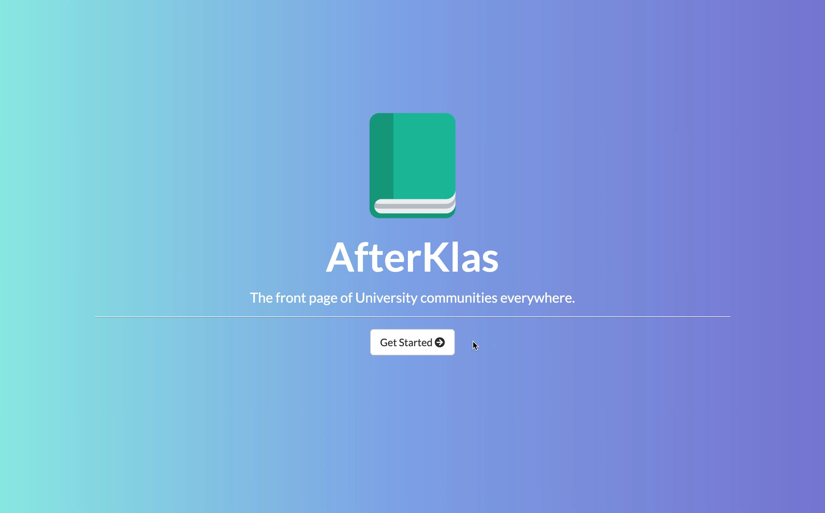
Intro - Demo

Slide 3
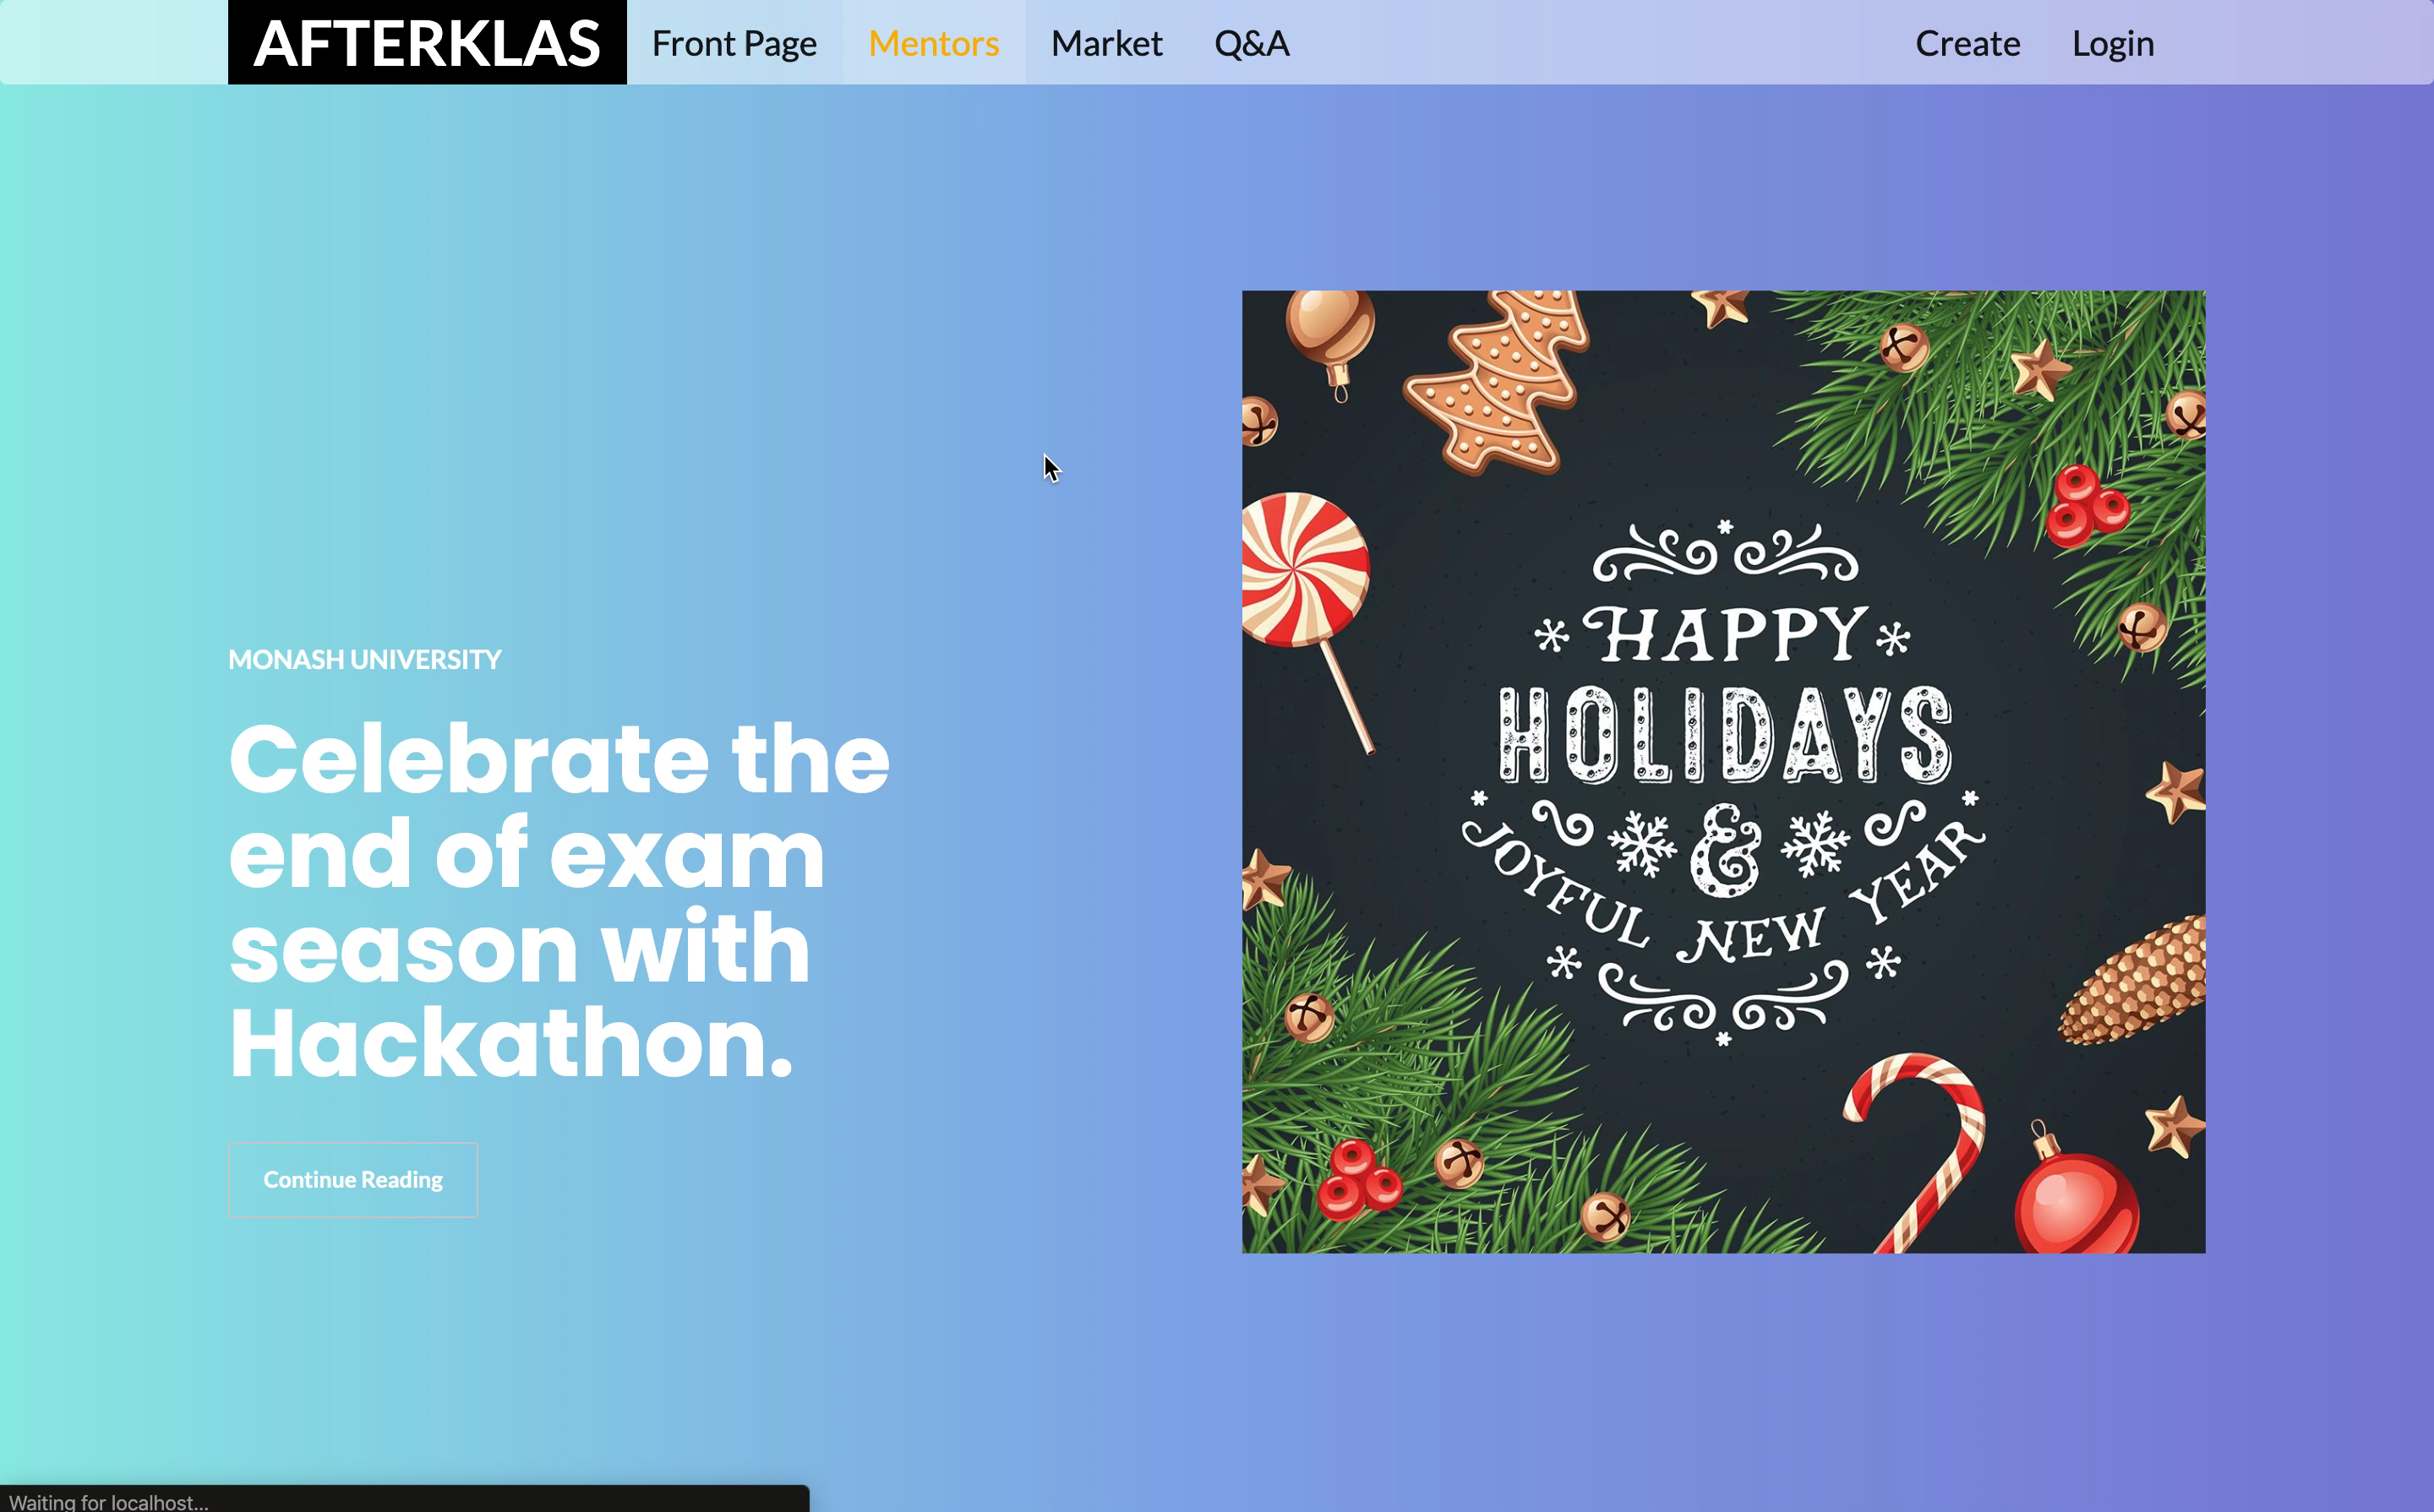
Mentors and Market - Demo

Slide 4
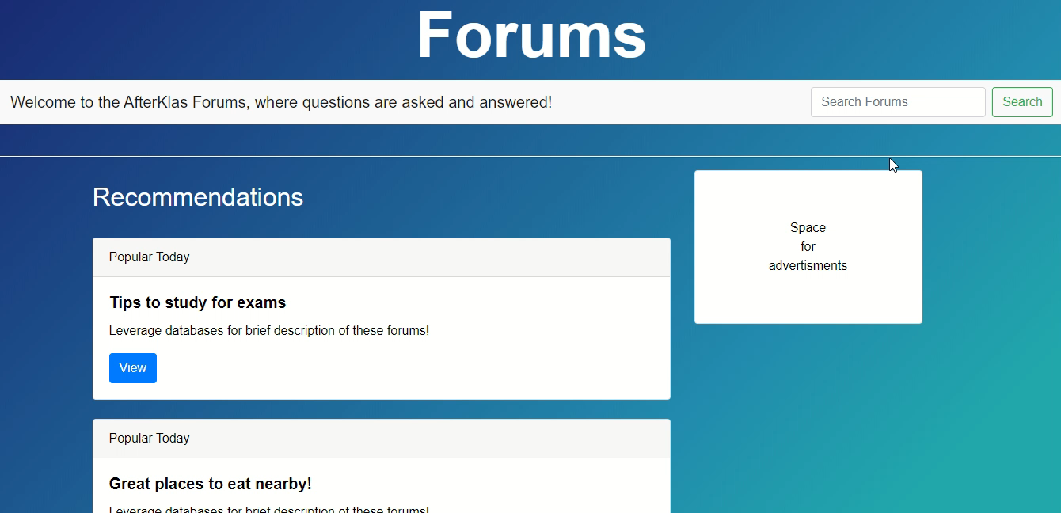
Forums - Demo

Slide 5
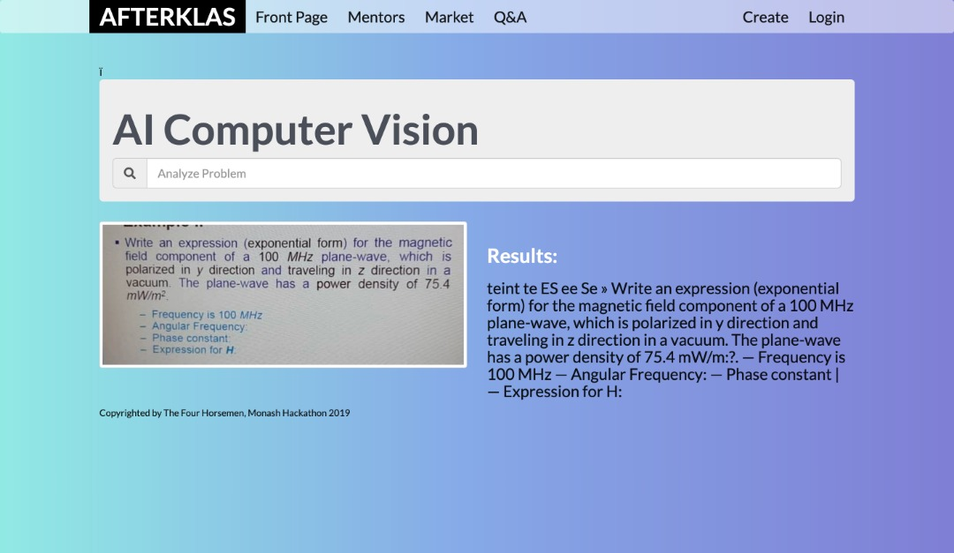
AI Vision to facilitate searches

Slide 6
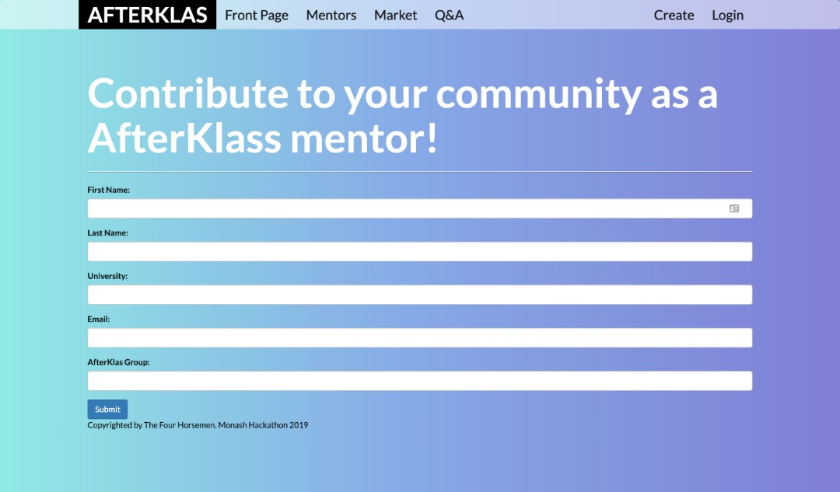
Bringing students together in one click - Groups

Slide 7
“In Class we rely on Teachers…”
“…After Class, we rely on each other…”
“…Thus AfterKlas was born.”

Slide 8
The End
Thank you for listening!

